Slide 1
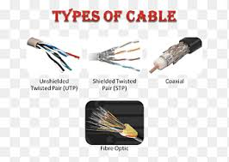


Transmission Media
Computer Networks / Data Communication
Name:-J.Thenmmozhy
Reg.no:-DCA1546
Course:-DITEC

Slide 2
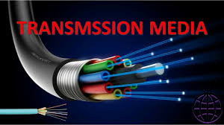
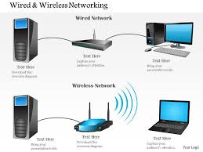
Introduction to Transmission Media
Transmission media is the path used to send data.
It connects one device to another.
Data travels as:
Electrical signals
Light signals
Radio waves
It is important in computer communication.
Examples
Network cables
Wi-Fi
Mobile signals
“Transmission media is the channel through which information moves from sender to receiver.”

Slide 3
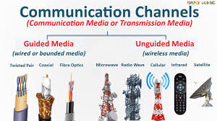
Types of Transmission Media
Guided Media (Wired)
Uses physical cables
Data moves through a fixed path
Examples:
Twisted Pair Cable
Coaxial Cable
Fiber Optic Cable
Unguided Media (Wireless)
Uses air or space
No physical cable needed
Examples:
Radio waves
Microwaves
Infrared
Satellite
“Transmission media is mainly divided into wired and wireless communication.”

Slide 4
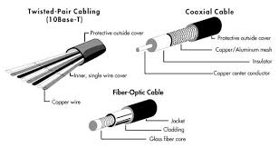
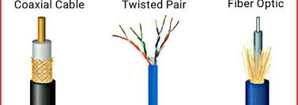
Guided Transmission Media
Twisted Pair Cable
Two copper wires twisted together
Used in telephone lines and LANs
Low cost
Coaxial Cable
Better shielding than twisted pair
Used in:
Cable TV
Internet connection
Fiber Optic Cable
Uses light for transmission
Very high speed
Used in:
Long-distance communication
Modern internet networks
Reliable
“Guided media uses cables to transfer data safely and efficiently.”

Slide 5
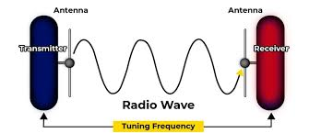
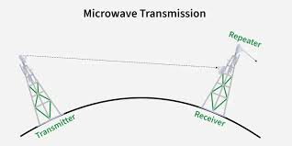
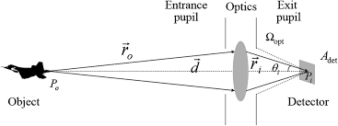
Unguided Transmission Media
Radio Waves
Used in:
Radio
Wi-Fi
Mobile networks
Microwaves
Used in:
Mobile towers
Long-distance wireless communication
Infrared
Used for short distances
Example:
TV remote

Slide 6
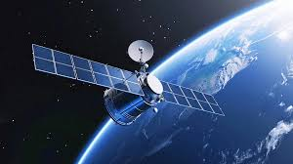
Satellite
Used for:
Television
GPS
Internet in remote areas
Advantages
No cables needed
Easy to install
“Unguided media sends signals through air and space without using cables.”

Slide 7
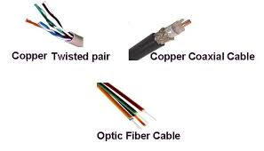
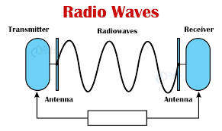
Comparison
Feature | Guided Media | Unguided Media
Medium | Physical cable | Air / Space
Speed | Usually higher | Moderate to high
Cost | Installation can be costly | Easier in some cases
Security | More secure | Less secure
Mobility | Limited | High

Slide 8

Conclusion
Conclusion
Transmission media is essential in networking.
It helps devices communicate with each other.
There are two main types:
Guided
Unguided
“Both wired and wireless media are important in modern communication.”

Slide 9

THANKYOU

